Slide 1

SESHADRI RAO GUDLAVALLERU ENGINEERING COLEGE
(An Autonomous Institute permanently affiliated to JNTUK , Kakinada)
Department of Electronics and Communication Engineering
Braille-Based IoT Home Automation for
Multi-Disability Empowerment
Batch No : C5
Batch Members:
N. Manikanta Raghava — 23485A0424
M. Jahnavi — 22481A04F5
N. Venkata Siva Prasanth — 23485A0423
Md. Habeeb Pasha — 22481A04F8
Guided by:
Mr. V. Vittal Reddy
(Associate Professor)

Slide 2
Objectives of the Project Work
Develop a low-cost, accessible Braille-based IoT system that empowers visually and speech-impaired individuals to control home appliances independently, providing real-time confirmation through haptic feedback and audio signals to ensure accuracy and ease of use.
Implement an intelligent emergency alert system that detects hazards like fire and instantly notifies caregivers via Blynk IoT cloud push notifications ensuring continuous safety and reliability during critical situations.

Slide 3
Abstract of the Project Work
This project presents a Braille-based IoT home automation system designed to assist visually and speech-impaired individuals. Built on ESP32 microcontrollers, the system employs a custom persistent TCP protocol to transmit commands from a portable six-dot Braille keypad to a central appliance controller. Accessibility is ensured through simultaneous haptic (vibration) and auditory feedback for the user, while an SSD1306 OLED display provides visual status for caregivers. Additionally, the system integrates flame sensors and Blynk IoT connectivity to provide real-time safety alerts, offering a secure, reliable, and inclusive alternative to conventional smart home controls.

Slide 4
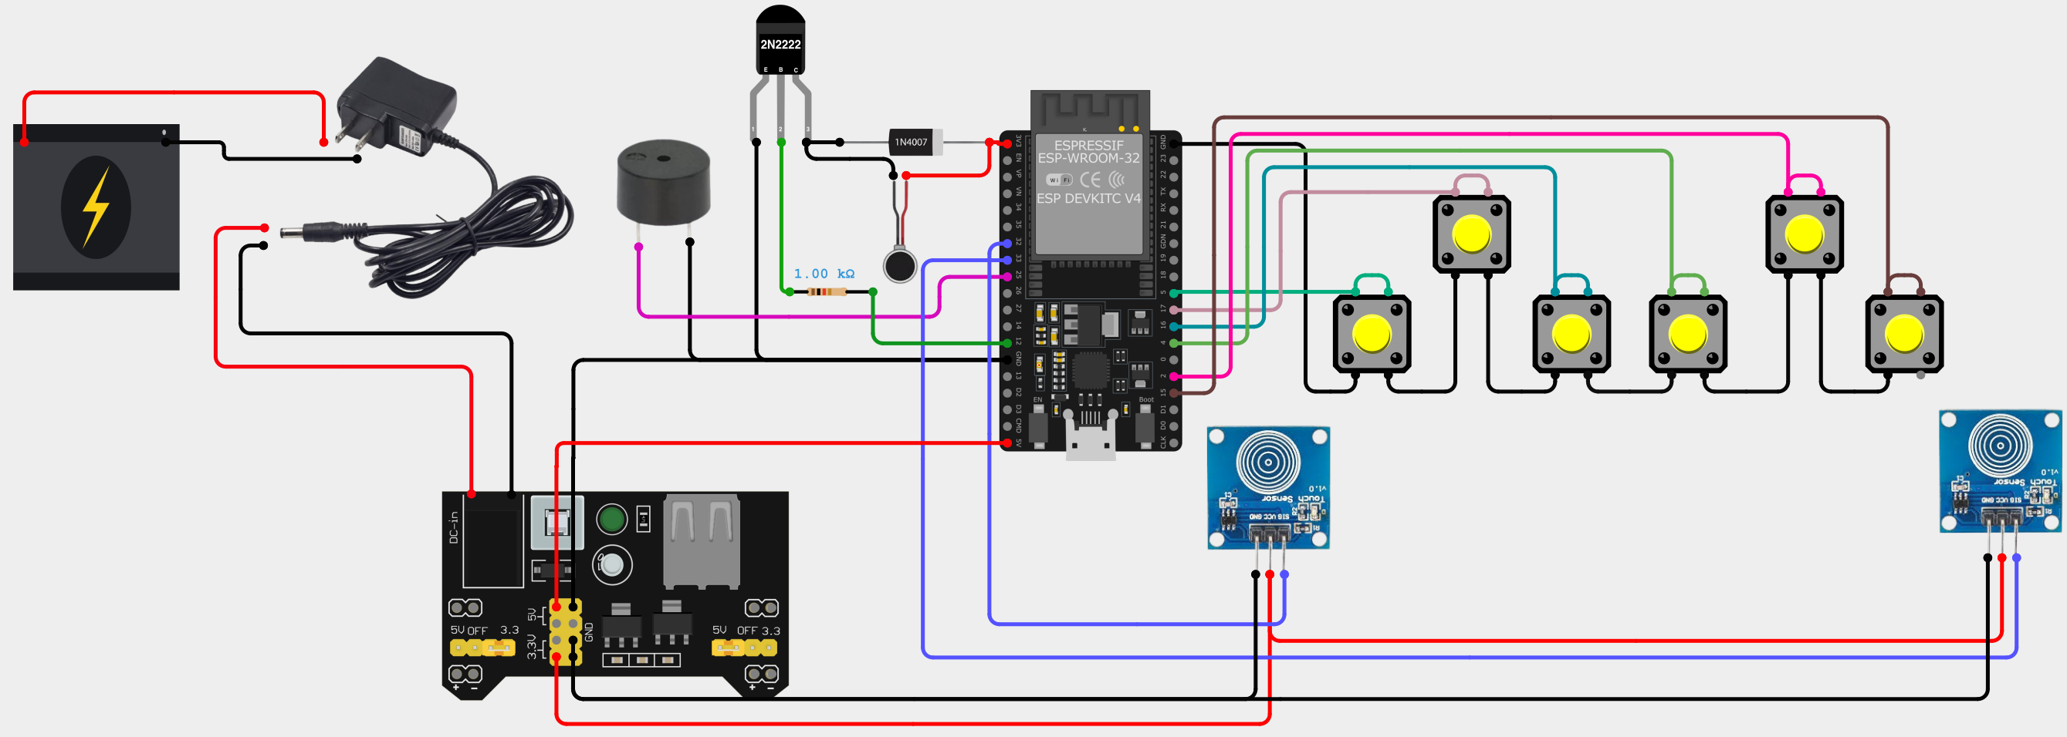
Hardware Wiring Diagram
Remote Module

Slide 5
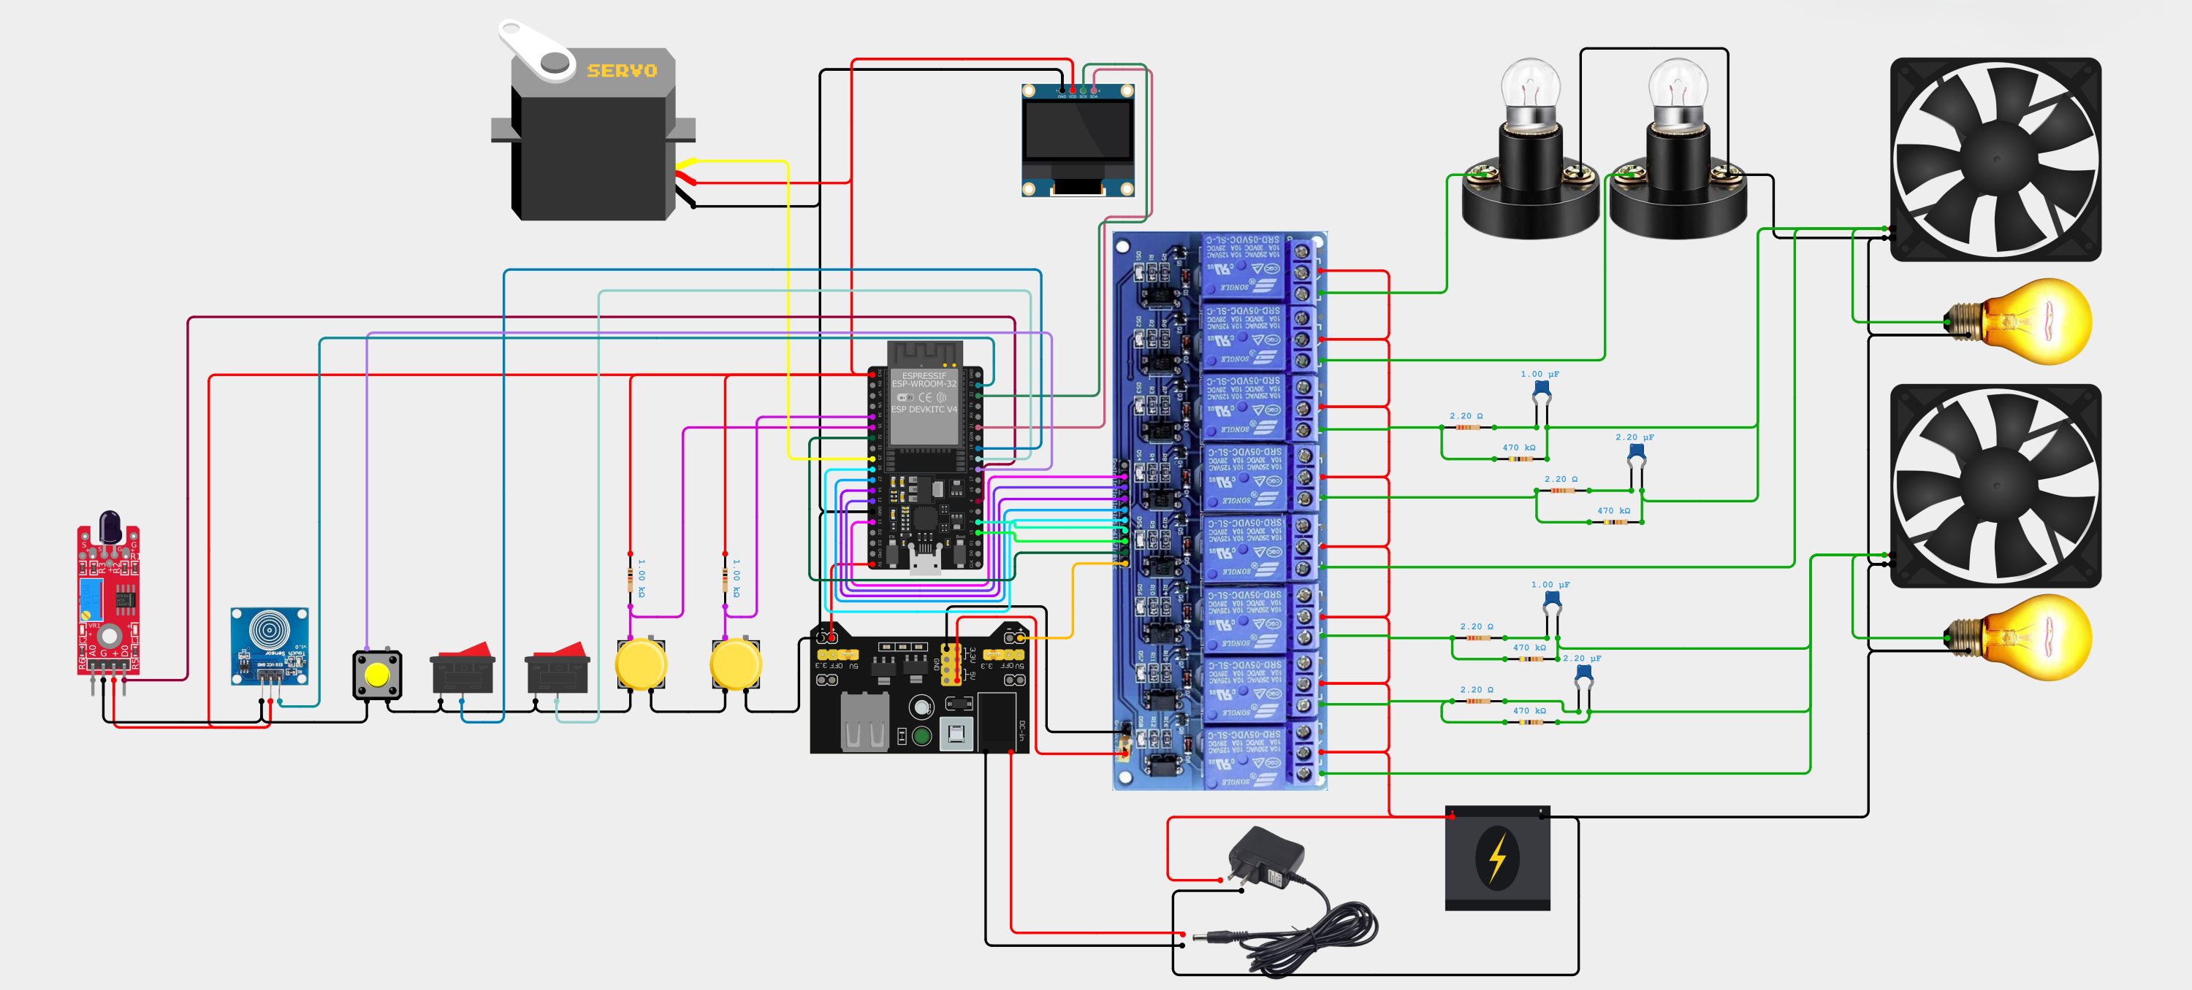
Hardware Wiring Diagram
Appliance Control Module

Slide 6
Flow chart
Braille Keypad Module
Power ON
Initialize sensors & Wi-Fi
Read inputs
Valid Braille Input
Send appliance command
No
Is Feedback Received from TCP
Yes
Play Feedback
Emergency
Send ACK or STOP
Appliance Control Module
S/E/C/W
feedback pattern →
Is Command Received
Initialize sensors, Wi-Fi & Display
Power ON
Listen TCP for commands
Yes
Decode command
Execute command & give Feedback
No
‘F’ fire alert
feedback pattern →
Update display
Is Flame detected
Monitor Flame sensor
Yes
Emergency alert
No

Slide 7
SYSTEM ARCHITECTURE
The Handshake: Master/Slave Model
Communication Protocol
Network Topology
01
Master/Slave Architecture
Remote Module (TCP Client) → Appliance Module (TCP Server)
Remote Module
02
WiFi Mode: WIFI_AP_STA
TCP Client
Dual-mode operation for flexible network configuration
Braille Input • Haptic Output
03
TCP Communication Port 7890
Reliable connection-oriented protocol for command transmission
TCP Port 7890
Key Code Implementation
Appliance Module
TCP Server
WiFiServer tcpServer(7890);
Relay Control • IoT Integration
WiFiClient activeClient;
// Server initialization in setup()
tcpServer.begin();
// Client connection handling in loop()
if (tcpServer.hasClient()) {
Network SSID
Password
activeClient = tcpServer.available();
ESP32-Server
12345678
}

Slide 8
REMOTE MODULE
Input Logic: The Braille Engine
Mode Differentiation Logic
Hardware Input System
Left Touch + Pattern = Number Mode
6
Braille Pushbuttons
When left touch sensor is activated during button press, pattern maps to digits 1-0 (A-J patterns).
btnPins[] array
Six buttons arranged in standard Braille cell pattern (2 columns × 3 rows). Each button represents one dot position.
detectedChar = (i < 9) ? (i + 1) + '0' : '0'
Right Touch + Pattern = Alphabet Mode
2
Touch Sensors
When right touch sensor is activated, pattern maps to letters A-Z using brailleMap[] lookup table.
touchLeft & touchRight
TTP223 capacitive touch sensors for mode selection and command confirmation.
detectedChar = brailleChars[i]
Bitwise Pattern Detection
Braille Lookup Table
// Read 6 buttons into binary pattern (Lines 206-209)
// brailleMap[] array (Lines 29-33)
byte pattern = 0;
const byte brailleMap[] = {
for (int i=0; i<6; i++) {
1, 3, 9, 25, 17, 11, 27, 19, 10, 26, // A-J
if (digitalRead(btnPins[i]) == LOW)
5, 7, 13, 29, 21, 15, 31, 23, 14, 30, // K-T
pattern |= (1 << i);
37, 39, 58, 45, 61, 53// U-Z
}
};

Slide 9
HAPTIC & AUDIO INTERFACE
Feedback Systems
Feedback Function Implementation
Feedback Patterns
voidtriggerFeedback(char type) {
S
Success
if (type == 'S') { // Success - 400ms
400ms short vibration/beep
digitalWrite(vibMotor, HIGH);
digitalWrite(buzzer, HIGH);
delay(400);
E
Error
digitalWrite(vibMotor, LOW);
800ms long vibration/beep
digitalWrite(buzzer, LOW);
}
else if (type == 'E') { // Error - 800ms
F
Fire Emergency
// Long vibration/beep pattern
Continuous loop until ACK/STOP
delay(800);
}
else if (type == 'C') { // Correct Password - 5× short
for (int i=0; i<5; i++) {
C
Correct Password
// 400ms ON, 200ms OFF × 5
5× short beeps/vibrations
}
}
}
W
Wrong Password
5× long beeps/vibrations
Hardware Pin Configuration
Vibration Motor
Buzzer
Design Principle: Non-visual interaction ensuring visually impaired users receive immediate tactile and auditory confirmation of all system actions.
Pin 12
Pin 25
NPN transistor driver (2N2222) with 1kΩ base resistor and 1N4007 flyback diode
Active piezo buzzer for audio feedback synchronized with vibration

Slide 10
SAFETY SYSTEM
Emergency Detection Logic (Client Side)
Emergency Trigger Mechanism
User Response Logic
1. Fire Detection Signal
Server sends character 'F' when flame sensor detects fire. Client immediately enters emergencyMode .
False Alarm
Hold ONE touch sensor
tcpClient.print("STOP\n")
2. Continuous Alert Pattern
Sends STOP command to cancel alert without triggering Blynk notification
System generates continuous short beeps/vibrations (400ms ON, 600ms OFF) until user responds.
OR
3. User Response Window
System monitors touch sensors for user confirmation within configurable timeout period.
Real Emergency
Hold BOTH touch sensors
Emergency Mode Entry
tcpClient.print("ACK\n")
Sends ACK command confirming emergency, triggers Blynk notification
// Lines 114-120: Fire alert detection
if (c == 'F') {
emergencyMode = true;
emergencyTimer = millis();
}
// Lines 127-137: Continuous alert pattern
if (millis() - emergencyTimer > 1000) {
digitalWrite(vibMotor, HIGH);
digitalWrite(buzzer, HIGH);
2-Second Validation
delay(400);
Code Line 314: User must hold sensor(s) for 2000ms to prevent accidental triggers
// ... alternating pattern
}

Slide 11
APPLIANCE MODULE
The Control Hub (Server Side)
TCP Server Implementation
Global State Variables
// Line 278: Server initialization
WiFiServer tcpServer(7890);
bool l1State, l2State
WiFiClient activeClient;
// Lines 445-454: Client connection handling
Light relay states (true=ON, false=OFF)
if (tcpServer.hasClient()) {
if (activeClient && activeClient.connected()) {
int fan1State, fan2State
// Reject new connection if one active
WiFiClient newClient = tcpServer.available();
Fan speed levels (0-4, where 0=OFF)
newClient.stop();
} else {
activeClient = tcpServer.available();
String lastCommand
}
Most recently executed command
}
bool fireActive
Command Parsing Loop
Emergency state flag
// Lines 455-563: Main command processing
if (activeClient && activeClient.connected()) {
while (activeClient.available()) {
char c = activeClient.read();
if (c == '\n') {
Response Codes
inputBuffer.trim();
lastCommand = inputBuffer;
S
Command executed successfully
// Parse and execute command...
activeClient.print(response);
E
Invalid command or error
} else {
inputBuffer += c;
}
}
}

Slide 12
COMMUNICATION PROTOCOL
Text-to-Action Command Mapping
Complete Command Reference
Command Structure
L1
Toggle Light 1 (Pin 13)
L1, L2
Light Control
Toggle light relays on Pins 13 (L1) and 12 (L2)
L2
Toggle Light 2 (Pin 12)
l1State = !l1State;
digitalWrite(RELAY_L1, l1State ? RELAY_ON : RELAY_OFF);
F11
Fan 1, Speed 1 (Low)
preferences.putBool("l1", l1State);
F24
Fan 2, Speed 4 (Max)
Fxy
Fan Control
x = Room (1,2), y = Speed (0-4)
ALL1
Master ON (All devices)
int r = inputBuffer.charAt(1) - '0';
int s = inputBuffer.charAt(2) - '0';
ALL0
Master OFF (All devices)
if (r==1) { fan1State=s; setFan1Speed(s); }
OPN
Open Door (Servo 90°)
Door Control (Line 688)
else if (inputBuffer == "OPN") {
Blynk Synchronization
doorServo.write(90);
doorOpenTime = millis();
// Lines 469, 477: Update Blynk virtual pins
doorAutoClose = true;
if(Blynk.connected())
response = 'S';
Blynk.virtualWrite(V1, l1State);
}
Blynk.virtualWrite(V2, l2State);
Blynk.virtualWrite(V3, fan1State);
Auto-closes after 5 seconds (Line 437-443)

Slide 13

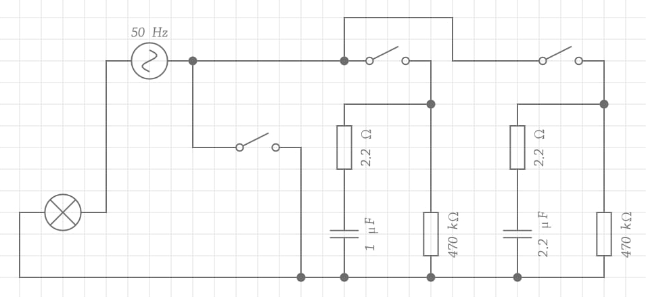
CAPACITOR BANK CONTROL
Fan Speed Logic
Hardware Implementation
Speed Level Matrix
Uses 3 relays per fan for speed regulation via capacitor switching (not PWM). This method provides smoother speed control for AC induction motors.
Speed | C1 | C2 | C_eff
0 (OFF) | 1.0µF | 2.2µF | 0µF
1 (Low) | 1.0µF | 2.2µF | 1.0µF
2 (Med-Low) | 1.0µF | 2.2µF | 2.2µF
3 (Med-High) | 1.0µF | 2.2µF | 3.2µF
4 (Max) | 1.0µF | 2.2µF | Bypass
Relay 1
Relay 2
Relay 3
1.0µF Cap
2.2µF Cap
Direct
setFan1Speed Function (Lines 351-362)
Circuit diagram of RC fan regulator
voidsetFan1Speed(int speed) {
Relay 1
Relay 2
if (speed == 0) {
// All relays OFF
digitalWrite(RELAY_F1_1, RELAY_OFF);
Relay 3
digitalWrite(RELAY_F1_2, RELAY_OFF);
digitalWrite(RELAY_F1_3, RELAY_OFF);
} else {
load
// Speed 1-4 logic
digitalWrite(RELAY_F1_1, (speed==1 || speed==3) ? RELAY_ON : RELAY_OFF);
digitalWrite(RELAY_F1_2, (speed==2 || speed==3) ? RELAY_ON : RELAY_OFF);
digitalWrite(RELAY_F1_3, (speed==4) ? RELAY_ON : RELAY_OFF);
}
}

Slide 14
SAFETY SYSTEM
Fire Safety State Machine
Three-State Safety System
State Transition Diagram
1
Detection
IDLE
IR Flame Sensor (Pin 4)
Normal Operation
Sensor detects fire (Active HIGH), sets fireActive = true, sends 'F' to Remote Module every 1000ms.
2
Awaiting Confirmation
Human-in-the-Loop
DETECTION
Blocks other inputs until "ACK" or "STOP" received from user via touch sensors.
Fire Detected → Send 'F'
3
Action (On ACK)
Any touch
Emergency Response
Opens door (Servo 90°), triggers Blynk notification, displays "Alert Confirmed" on OLED.
AWAITING
Wait for ACK/STOP
Fire Detection Loop (Lines 638-647)
if (digitalRead(FLAME_PIN) == HIGH) {
ACK
STOP
if (!fireActive) {
CONFIRMED
CANCELLED
fireActive = true ;
Blynk + Door
Silent Stop
updateOled( "!! FIRE !!" );
}
if (millis() - lastFireMsg > 1000 ) {
lastFireMsg = millis();
Safety-First Design
activeClient.print( 'F' );
}
The human-in-the-loop verification prevents false IoT alerts due to sensor errors or transient conditions. Emergency notifications are only sent after explicit user confirmation.
}

Slide 15
HYBRID INPUT SYSTEM
Manual "Smart Button" Logic
Dual-Mode Button Operation
State Management Variables
Short Press
unsigned long btn1PressStart
< 500ms
Records button press start time for duration calculation
Toggles device ON/OFF. If fan is running, saves current speed to savedFan variable before turning off.
bool btn1Active
Long Press
Tracks if button is currently being pressed
> 500ms
Cycles through speed levels: 1 → 2 → 3 → 4 → 1. Implements 500ms interval between speed changes.
bool btn1LongPress
Flags long press to prevent toggle on release
Debouncing Implementation
int savedFan1
Stores last speed setting for resume functionality
// Lines 649-686: Fan button with debounce
if (f1Btn == LOW && lastBtn1State == HIGH) {
unsigned long lastFan1Change
btn1PressStart = millis();
500ms interval timer between speed increments
btn1Active = true;
}
if (f1Btn == LOW && btn1Active) {
if (millis() - btn1PressStart > 500) {
Speed Cycling Logic
// Long press detected
btn1LongPress = true;
}
if (fan1State == 0) fan1State = 1;
}
else {
fan1State++;
if (fan1State > 4) fan1State = 1;
}

Slide 16
ACCESS CONTROL
Security System – The "1010" Logic
Two-Input Binary Entry System
Password Entry Flow
1
Enter Bit
Hold button for '1', release for '0'
Button (Pin 5)
Touch (Pin 23)
Data Bit
Clock/Enter
2
Clock Bit
Pressed = 1
Released = 0
Short = Bit Entry
Long = Submit
Short tap touch sensor (<1s)
3
Repeat
User enters binary password by holding button (for '1') or releasing (for '0'), then tapping touch sensor to clock in each bit. Long press on touch submits password for validation.
Continue for all 4 bits
4
Submit
Long press touch (>2s)
Password Validation (Lines 614-625)
Example: 1-0-1-0 = Access Granted
const String CORRECT_PASSWORD = "1010";
if (passInput == CORRECT_PASSWORD) {
updateOled("Access\nGRANTED");
Haptic Feedback Response
activeClient.print('C'); // Send correct feedback
passInput = "";
} else {
C
Correct
updateOled("Access\nDENIED");
5 short beeps/vibrations
activeClient.print('W'); // Send wrong feedback
passInput = "";
}
W
Wrong
5 long beeps/vibrations

Slide 17
CLOUD CONNECTIVITY
IoT Integration (Blynk Cloud)
Blynk Library Integration
Virtual Pin Mapping
// Lines 243-245: Blynk configuration
V1
Light 1 State
#define BLYNK_TEMPLATE_ID "TMPL3VTwLUsho"
Boolean (0/1)
#define BLYNK_TEMPLATE_NAME "BRAILLE ASSISTIVE HOME"
#define BLYNK_AUTH_TOKEN "xFRDYtkIVA-pcnq9-d_y8FMOUg57N_j2"
#include
V2
Light 2 State
Boolean (0/1)
Blynk is a low-code IoT platform trusted by 5,000+ companies and over 1 million developers worldwide.
V3
Fan 1 Speed
Integer (0-4)
V4
Fan 2 Speed
Bidirectional Data Sync
Integer (0-4)
// Hardware → App (Lines 361, 469, 477)
Blynk.virtualWrite(V1, l1State);
Critical Push Notification
Blynk.virtualWrite(V3, fan1State);
// App → Hardware (Blynk handlers)
// Line 717: Fire alert notification
BLYNK_WRITE(V1) {
if(Blynk.connected()) {
l1State = param.asInt();
Blynk.logEvent("fire_alert",
digitalWrite(RELAY_L1, l1State);
"Fire Alarm Confirmed by User!");
}
}
Safety Feature: Notification only triggers on user-confirmed emergency (ACK), preventing false alarms.

Slide 18
USER INTERFACE
OLED Display Management
Adafruit SSD1306 Library
Dynamic UI Layout
#include
// Display initialization (Line 281)
CMD: L1
Adafruit_SSD1306 display(128, 64, &Wire, -1);
L1: 1 L2: 0
// I2C pins (Lines 265-266)
#define OLED_SDA 21
F1: 4 F2: 2
#define OLED_SCL 22
128×64 pixel monochrome OLED display provides visual feedback for sighted caregivers and debugging information.
1
Line 1: Last Received Command (truncated to 5 chars)
2
Line 2: Light States (L1, L2: 0=OFF, 1=ON)
showStatus Function (Lines 328-348)
3
Line 3: Fan Speeds (F1, F2: 0-4)
voidshowStatus() {
display.clearDisplay();
display.setTextSize(2);
display.setTextColor(WHITE);
// Line 1: Last Command
display.setCursor(0, 0);
Special Display Modes
display.print("CMD:");
display.println(lastCommand.substring(0,5));
// Line 2: Light Status
Fire Emergency
display.print("L1:"); display.print(l1State);
Displays "!! FIRE !!"
display.print(" L2:"); display.println(l2State);
// Line 3: Fan Status
display.print("F1:"); display.print(fan1State);
Password Entry
display.print(" F2:"); display.println(fan2State);
Shows "PW: 101" as typed
display.display();
}

Slide 19
FLASH STORAGE
Data Persistence (Preferences)
The Problem
The Solution
Power loss resets all relay states. Without persistence, all lights and fans return to OFF after power restoration, disrupting user experience and requiring manual reconfiguration.
ESP32 Preferences.h library provides non-volatile storage (NVS) in flash memory. Data persists across resets and power failures.
#include
Preferences preferences;
Power Loss
After Reset
// Initialize namespace (Line 410)
All states lost
Defaults restored
preferences.begin("home_auto", false);
Save State (On Change)
Restore State (On Boot)
// Lines 468, 476: Save light states
// Lines 411-414: Restore from flash
preferences.putBool("l1", l1State);
l1State = preferences.getBool("l1", false);
preferences.putBool("l2", l2State);
l2State = preferences.getBool("l2", false);
// Lines 485, 490: Save fan states
fan1State = preferences.getInt("f1", 0);
preferences.putInt("f1", fan1State);
fan2State = preferences.getInt("f2", 0);
preferences.putInt("f2", fan2State);
// Apply restored states (Lines 417-420)
digitalWrite(RELAY_L1, l1State ? RELAY_ON : RELAY_OFF);
setFan1Speed(fan1State);
Namespace: "home_auto" | Data Types: bool, int, String | Max Key Length: 15 characters

Slide 20
CONCLUSION
Summary & Project Impact
Code Efficiency
Accessibility
Safety
Non-blocking architecture using millis() enables multitasking without interrupt delays.
Converts binary physical inputs into complex TCP command strings, enabling independent home control for visually impaired users.
Human-in-the-loop verification for fire alarms prevents false IoT alerts and ensures reliable emergency response.
Button debouncing
Emergency timers
Standard Braille input
2-second validation
WiFi reconnection
Haptic & audio feedback
ACK/STOP confirmation
Speed cycling intervals
Mode differentiation
Automatic door opening
Non-visual interface
Blynk push notifications
A Robust Dual-Module System
2
15
5
Bridging Braille physical inputs with modern IoT infrastructure, demonstrating how embedded systems engineering can enhance independence and quality of life for visually impaired users.
ESP32 Modules
Commands
Feedback Types

